Slide 1
Brachial Plexus Injuries
Dr. Sanket Mungikar
Dept. Of Musculoskeletal Physiotherapy
MGM Institute Of Physiotherapy
Chh.Sambhajinagar

Slide 2
Contents
Anatomy of the Brachial Plexus
Mechanisms of Brachial Plexus Injury
and Pathologies
Neurological Evaluation for the Brachial Plexus and Related Special Tests

Slide 3
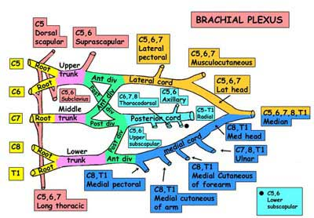

Slide 4
Paediatric Injuries
History
1764 Obstetrical brachial palsy described by Smellie.
1874 Wilhelm H. Erb described brachial plexus paralysis in adults which involved the upper roots and described certain types of “delivery paralysis”. He credited Duchenne for describing the brachial palsy following delivery in affected newborns.
1885 Augusta Klumpke first described the clinical picture resulting from injury to lower roots.

Slide 5
Paediatric Injuries
Although injuries can occur at any time, many brachial plexus injuries happen when a baby's shoulders become impacted during delivery and the brachial plexus nerves stretch or tear.
Assoc with: large baby, difficult delivery, gestational diabetes, polyhydramnios, older mum
Incidence = 0.5 to 1.9 per 1000 live births (Bar et al 2001); Brachial plexus palsy occurs in 26% of cases of shoulder dystocia; 90% Erb palsy
Most common on the right side because the most common delivery presentation is left occiput anterior vertex.
Newborns with BP injuries have a higher incidence of low Apgar scores of less than 7 at 1 and 5 mins and of asphyxia than matched controls

Slide 6
Paediatric Injuries
Types of brachial plexus injuries:
  avulsion, the most severe type, in which the nerve is torn from the spine
  rupture, in which the nerve is torn but not at the spinal attachment
  neuroma, in which the nerve has torn and healed but scar tissue puts pressure on the injured nerve and prevents it from conducting signals to the muscles
  neuropraxia or stretch, in which the nerve has been damaged but not torn; most common type of brachial plexus injury
Treatment:
  Conservative: Many children who are injured during birth improve or recover by 3 to 4 months of age. Treatment for brachial plexus injuries includes physical therapy and, in some cases, surgery.
Prognosis: The site and type of brachial plexus injury determines the prognosis. For avulsion and rupture injuries, there is no potential for recovery unless surgical reconnection is made in a timely manner. The potential for recovery varies for neuroma and neuropraxia injuries. Most individuals with neuropraxia injuries recover spontaneously with a 90-100% return of function.

Slide 7
Paediatric Injuries
What is your management of the obstetric brachial plexus injury?
History: Large baby; difficult delivery; shoulder distocia; maternal DM
Examination: try to determine level
  At bith: look at upper limb posture
  At 3/12: look for elbow flexion (sign of recovery)
  When older ask them to take off shirt and watch
Investigations: MRI, myelogram
Management:
  Physio: passive stretch; maitain FPROM; prevent contractures
  Surgery at 3/12 (20%): explore neck via L-shaped incision in posterior triangle; nerve graft vsneurolysis (give preference to lower roots, so they develop hand and elbow function)
  Surgery at 8 yrs: tendon transfers

Slide 8
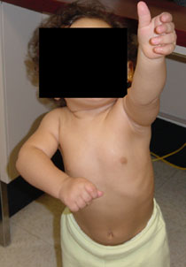
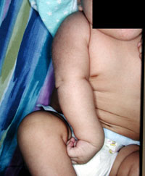
Observe Posture and Movements
Baby will just lie there! Ask mum if both arms move / twitch. Dangle some keys to see if it will reach out?
Baby will just lie there! Ask mum if both arms move / twitch. Dangle some keys to see if it will reach out?
This child can not reach up!

Slide 9
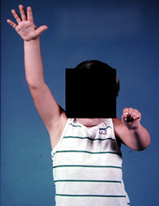
Observe Posture and Movements
Get child to undress and see how he gets on
Comment on what u see!

Slide 10
Brachial Plexus Injury: Adults
High-energy trauma to the upper extremity and neck causes a variety of lesions to the brachial plexus.
The common mechanism is violent distraction of the entire forequarter from the rest of the body ie motorcycle accident or a high-speed motor vehicle accident. A fall from a significant height may also result in brachial plexus injury.
Sports most commonly associated with brachial plexus injuries include: Am football, baseball, basketball, volleyball, fencing, wrestling, and gymnastics
Nerve injuries can result from blunt force trauma, poor posture, or chronic repetitive stress
Patients generally present with pain and/or muscle weakness
Over time, some patients may experience muscle atrophy
Loss of useful function of the upper extremity is common

Slide 11
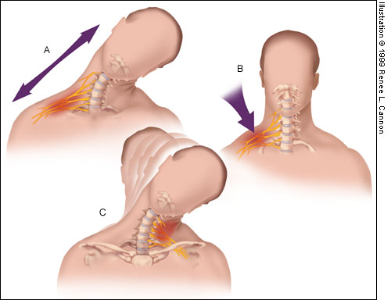
Mechanisms of
Injury to the Brachial Plexus
Traction: direct blow to the shoulder with the neck laterally flexed toward the unaffected shoulder (gymnast falls on beam)
Direct trauma: direct blow to the supraclavicularfossa over Erb’s point
C. Cervical Nerve Compression: Occurs when the neck is flexed laterally toward the patient’s affected shoulder, compressing / irritating the nerves, resulting in point tenderness over involved vertebrae of affected nerve(s)
(Troub, 2001)

Slide 12
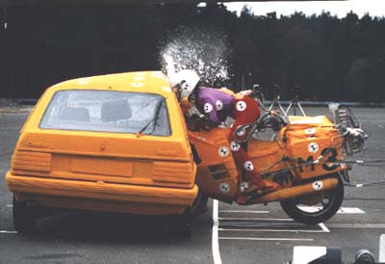
Mechanisms of
Injury to the Brachial Plexus

Slide 13
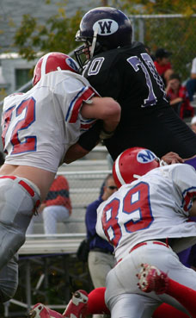
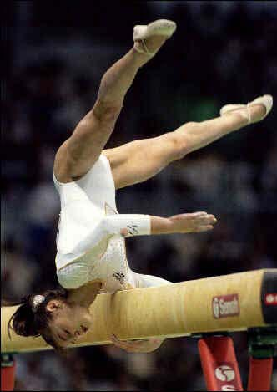
Mechanisms of
Injury to the Brachial Plexus

Slide 14
Injury Classification
Millesi classification*
Supraganglionic
Infraganglionic
Trunk
Cord
Anatomical Classification
C5-6 waiters tip (Erbs palsy)
C5-7 as above, elbow slightly flexed
C5-T1 flail limb, claw hand, vasomotor changes, +/- Horners syndrome

Slide 15
Grades of Injury
Grade 1 – Neuropraxia
  Disruption in nerve function that produces numbness and tingling
  Most common grade within athletics
  Symptoms usually resolve within several minutes
Grade 2 – Axonotmesis
  Damage to the nerve’s axon
  Symptoms = numbness, tingling, and affected function (may last several days)
  Long nerves have a greater healing time than short nerves
  Rare within athletics
Grade 3 – Neurotmesis
  Permanent nerve damage occurs
  Very rare within athletics
  “Occurs with high-energy trauma, fractures, and penetrating injuries”

Slide 16
Adult Brachial Plexus Injury
How do you Rx the patient knocked off his motorcycle with clavicle # and flail arm?
Manage acute injury according to ATLS principles; look for concomitant injury iec-spine.
History
  Age, handedness, occupation, special skills
  Cause of injury: arm hyperabductedvs neck laterally flexed
  Immediate or delayed arm weakness
  Concomitant injury
  General health: PMH, DH, Smoker

Slide 17
Adult Brachial Plexus Injury
Examination (use pre-printed brachial plexus diagrams): determine level
Look at face: does he have Horner’s? (=lower root lesion C8 T1)
Undress upper torso
Look from front at posture of arm, scars, muscle wasting, asymmetry/swelling
Look at back again for scars, muscle wasting, asymmetry
  Test sp. Accessory n (shrug shoulders)
  Supraspinatus responsible for 1st 20° of shoulder abduction (resisted arm abduction)
  Rhomboids (touch back of head)
  Lat dorsi (press both hands into hips and cough)
Look at vascularity of arm
Check sensation both upper limbs (root levels)
Check movement both upper limbs from shoulder to fingers (AROM + PROM)
Reflexes
Function of phrenic nerve

Slide 18
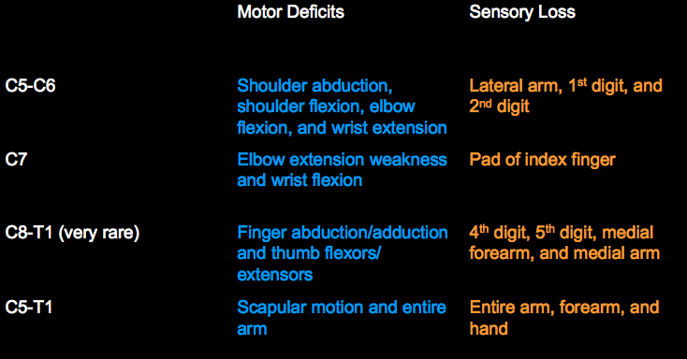
Neurological Examination

Slide 19
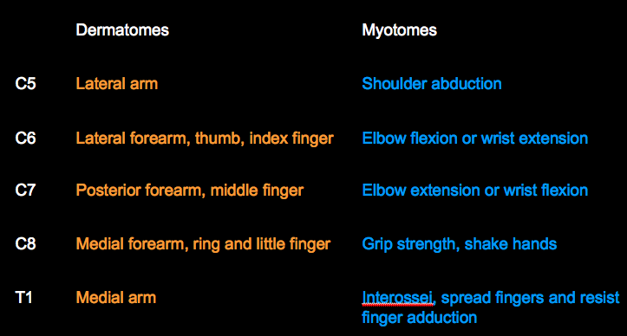
Neurological Examination

Slide 20
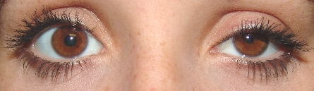
Examination
LOOK, FEEL, MOVE (Talk as you are doing)
Manage according to EMST/ATLS in acute setting. Abrasions to the head, helmet, or tip of the shoulder suggest supraclavicular injury.
Look at the face: Ptosis, myosis and anhydrosis (Horner syndrome) suggest a complete lower plexus lesion

Slide 21
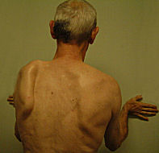
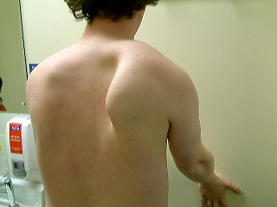
Examine the Back
Wall test for serratus ant (winging scapula)
Note weak trapezius (asymmetric shrug)

Slide 22
Examine the Back
Swelling about the shoulder can be dramatic. Diminished or absent pulses suggest vascular injury, and special consideration should be given to rupture of the subclavian vessels. Clavicle fractures are often palpable. Careful inspection and palpation of the axial skeleton may reveal concomitant injuries. Examine each cervical root individually for motor and sensory function as soon as circumstances allow.

Slide 23
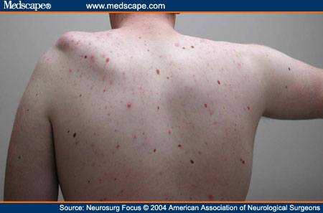
Examine the Back
Photograph showing patient with left shoulder subluxation resulting from a flail arm caused by C5–T1 lesions. Note the left deltoid, supra-, and infraspinatus muscle atrophy

Slide 24

Examine the Back
Is lat dorsi present?

Slide 25
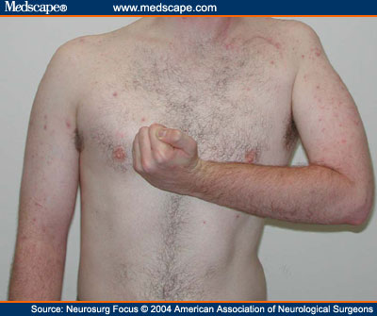
Examine Front
Notice clavicular scar, posture, wasting of Deltoid and biceps

Slide 26
Examine Front
If you see a flap mention it and look for the donor site!

Slide 27
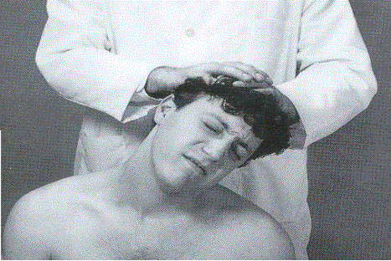
Examine the Neck

Slide 28
Related Special Tests
Brachial Plexus
Cervical Compression Test
Cervical Distraction Test
Spurling’s Test
Brachial Plexus Traction Test
Thoracic Outlet Syndrome
Adson’s Test
Allen’s Test
Military Brace Position

Slide 29
Peripheral Nerve Tests
Axillary N.
Sensory – Lateral arm
Motor – Shoulder abduction
Musculocutaneous N.
Sensory – Anterior arm
Motor – Elbow flexion
Radial N.
Sensory – 1st Dorsal web space
Motor – Wrist extension and thumb extension
Median N.
Sensory – Pad of Index finger
Motor – Thumb pinch and abduction
Ulnar N.
Sensory – Pad of little finger
Motor – Finger abduction

Slide 30
Reflex Tests
C5 – Biceps brachii reflex (anterior arm near antecubitalfossa)
C6 – Brachioradialis reflex (lateral aspect of forearm)
C7 – Triceps brachii reflex (at insertion of tricepbrachii)
C8 and T1 do not have reflex tests

Slide 31
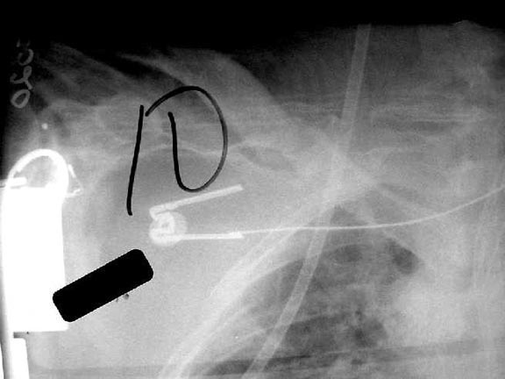
Investigations
Imaging: Xray: AP chest (look for teeth and fractures ), AP + lat views shoulder, C-Spine (AP, lat, odontoid peg), Fine-cut CT, MRI

Slide 32
Investigations
Sensory nerve action potentials (SNAPs): differentiate preganglionic from postganglionic injuries.
Electromyography (EMG): In the first week after injury, EMG cannot be used to exclude a complete disruption unless voluntary motor unit action potentials are observed. If no signs of denervation are present in a paralyzed muscle by 3 weeks after injury, EMG can be used to confirm a neuropraxia.
Somatosensory evoked potentials (SSEPs): In general, SNAPs are more reliable than SSEPs. Many difficulties exist with SSEPs, and they are not widely used.

Slide 33
Management
Medical: MDT
  physio: maintain supple joints with FROM
  Orthoptists / splinting
  Pain control
Surgical options:
  nerve transfers
  nerve grafting
  muscle transfers
  free muscle transfers
  neurolysis of scar in incomplete lesions
  Arthrodesis to stabilise joints

Slide 34
Management
Surgical options: Immediate vs delayed (timing contraversial)
  Indications for Surgery at time of injury
    Open injury
    High energy injury
    Supraclavicular injury
    Associated depressed clavicle fracture
    :explore and immediate repair / nerve grafts
  Surgery 3/12 post injury IF CLOSED (and no sign recovery): nerve grafts (if not done B4); nerve transfer if supraganglionic
  Surgery >1 year post injury: local or free muscle transfer starting at proximal joint (eg 2-stage reconstruction with sural nerve cross-thorax graft, attached to nerve to pec minor or long thoracic, then free contralat LD)

Slide 35
Planning for Reconstruction
What is the loss?
What is the need?
What is possible?
What is available?
What are the other injuries?
Is later surgery needed and what can be done now?

Slide 36
What is the loss?
Shoulder motion
Shoulder stability
Elbow flexion
Wrist and hand function
Sensation
Pain
Trophic changes
Body image

Slide 37
What is available?
Primary repair: Very rare
Neurolysis only with late surgery
Plexus anatomical cable grafting
Nerve transfers
  Accessory nerve
  Cervical plexus
  Phrenic nerve
  Intercostal nerves
  Ulnar ECU nerve
  Crossed C7
  Hypoglossal nerve
Nerve grafts
  Sural
  medial cutaneous forearm
  ulnar (vascularised)

